Slide 1

Diabetes
Hypothesis:

Slide 2
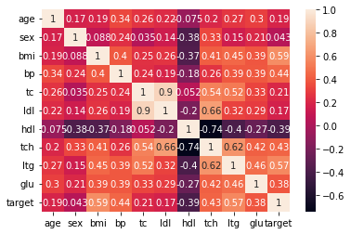
Correlation between variables in the diabetes dataset
What we learn:
The diabetes disease (target) is highly correlated with sex, BMI, average blood pressure (bp), high-density lipoprotein (hdl), possibly log of serum triglyceride levels (ltg) and blood sugar level (glu).
And slightly correlated to age, total serum cholesterol (tc) low-density lipoprotein (ldl)

Slide 3
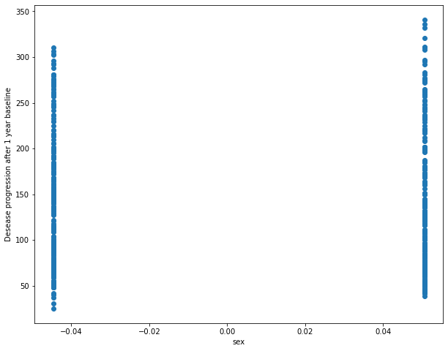
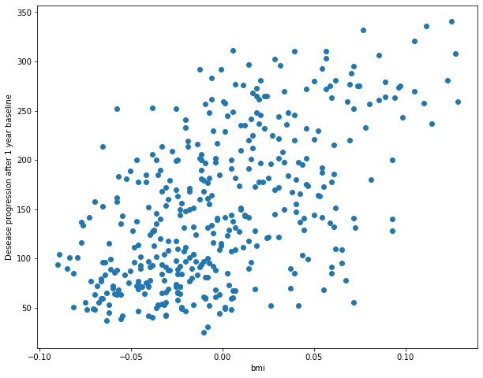
Checking trends of correlation between variables and diabetes desease

Slide 4
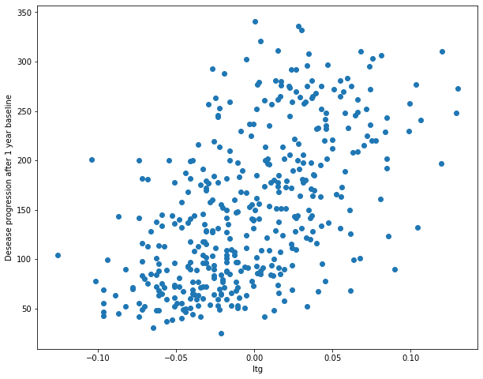
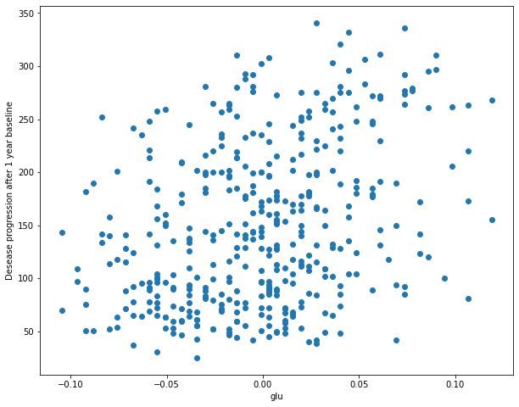
Checking trends of correlation between variables and diabetes disease

Slide 5
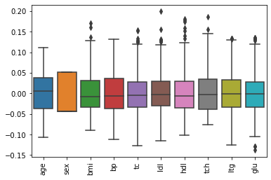
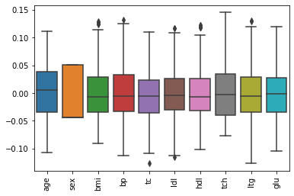
Box plot of ten features
Before detection of outliers
Remove out outliers

Slide 6
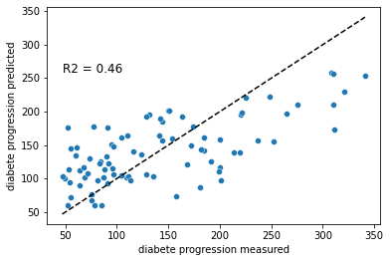
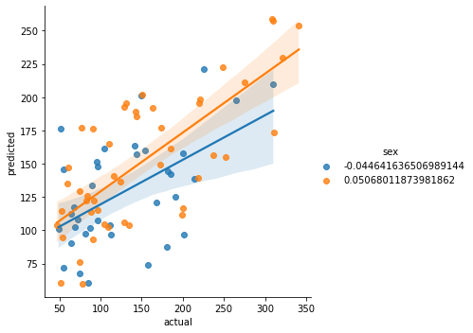
Simple linear regression

